Slide 1
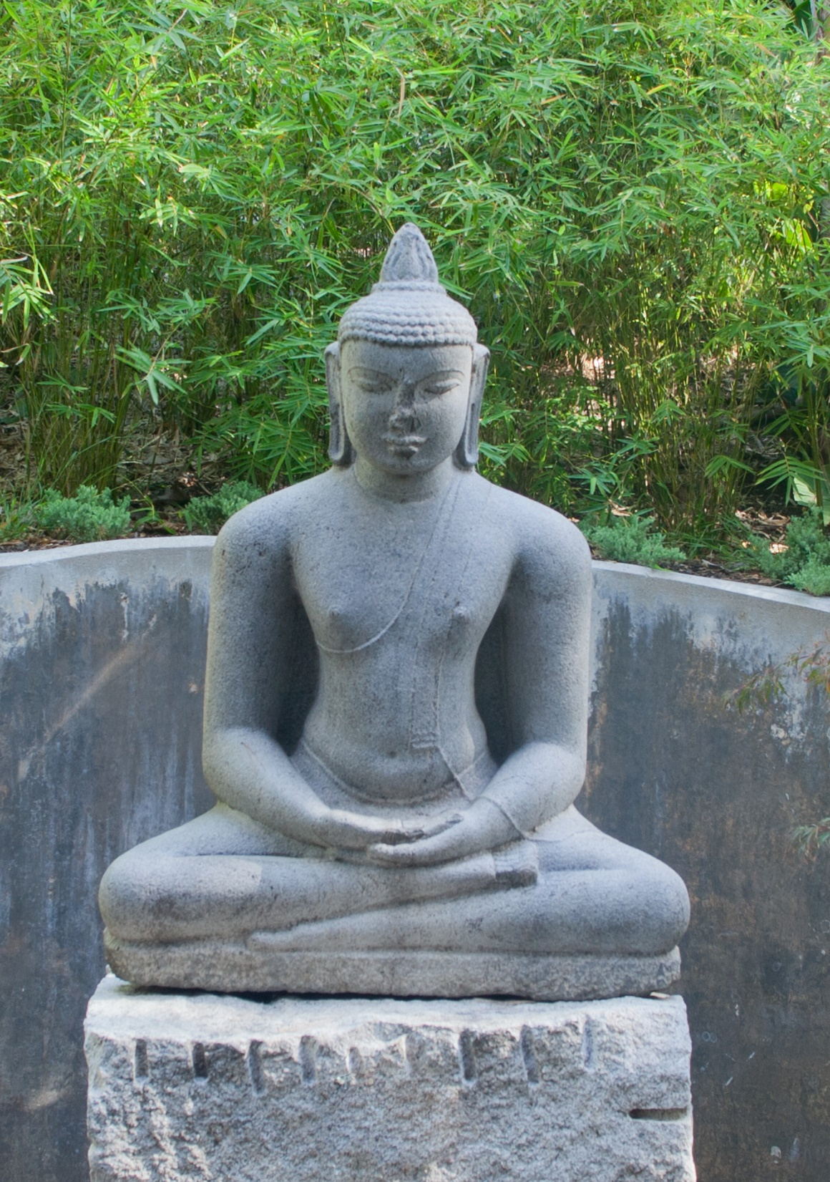
Notes:
Buddha Shakyamuni, c. 1100
India: Tamil Nadu
Granite
The Norton Simon Foundation
https://www.nortonsimon.org/art/detail/F.1975.17.03.S

Slide 2
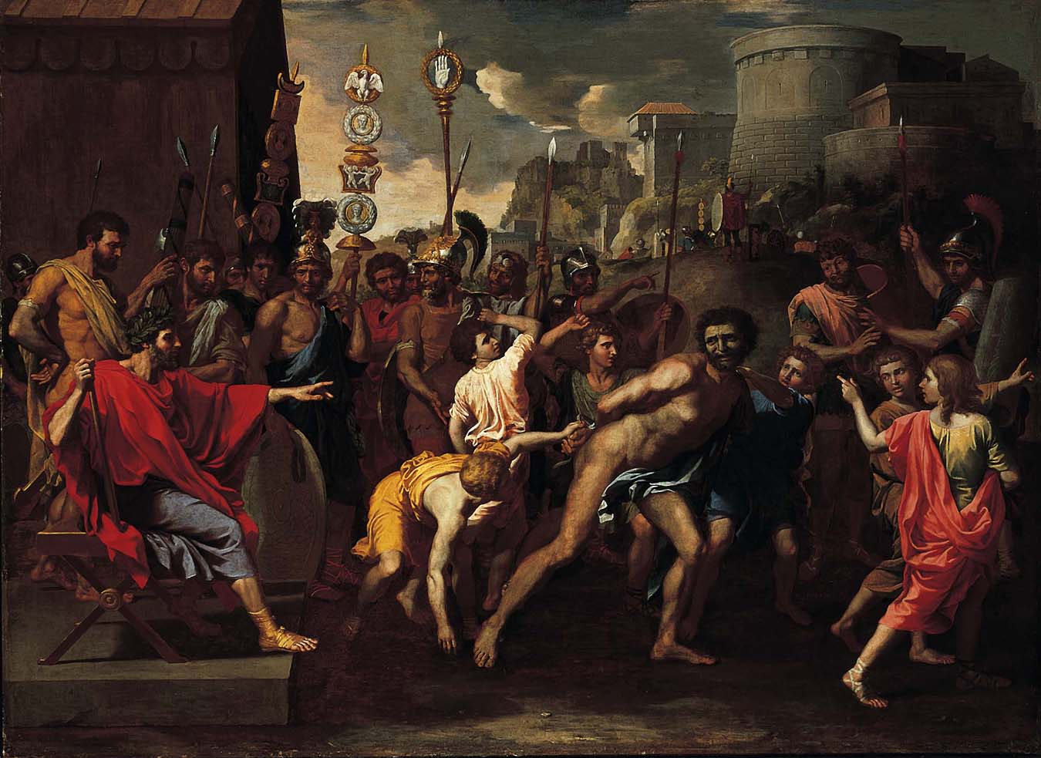
Notes:
Nicolas Poussin (French, 1594–1665)
Camillus and the Schoolmaster of Falerii, c. 1635–40
Oil on canvas
The Norton Simon Foundation
https://www.nortonsimon.org/art/detail/F.1970.14.P/

Slide 3
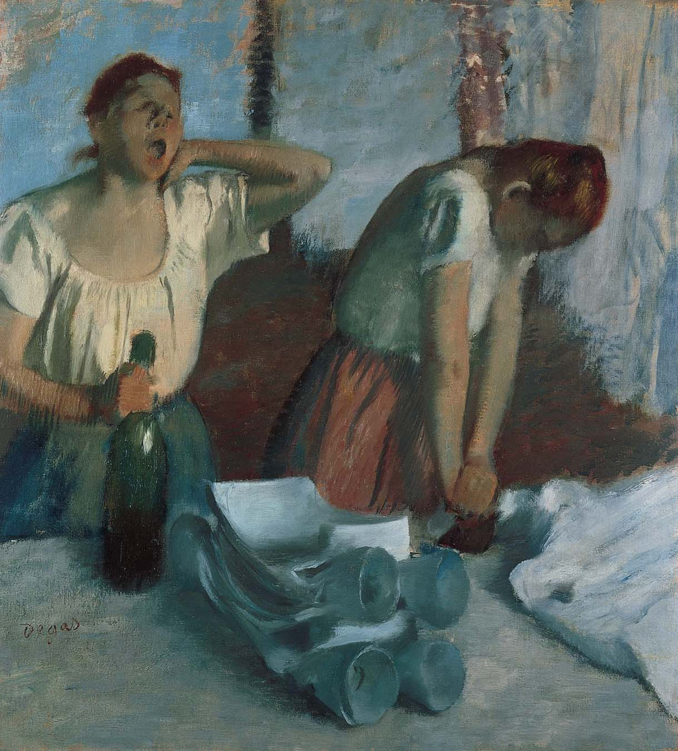
Notes:
Edgar Degas (French, 1834–1917)
Women Ironing, Begun c.1875–1876; reworked c.1882–1886
Oil on canvas
Norton Simon Art Foundation
https://www.nortonsimon.org/art/detail/M.1971.3.P/M.1979.17.P

Slide 4
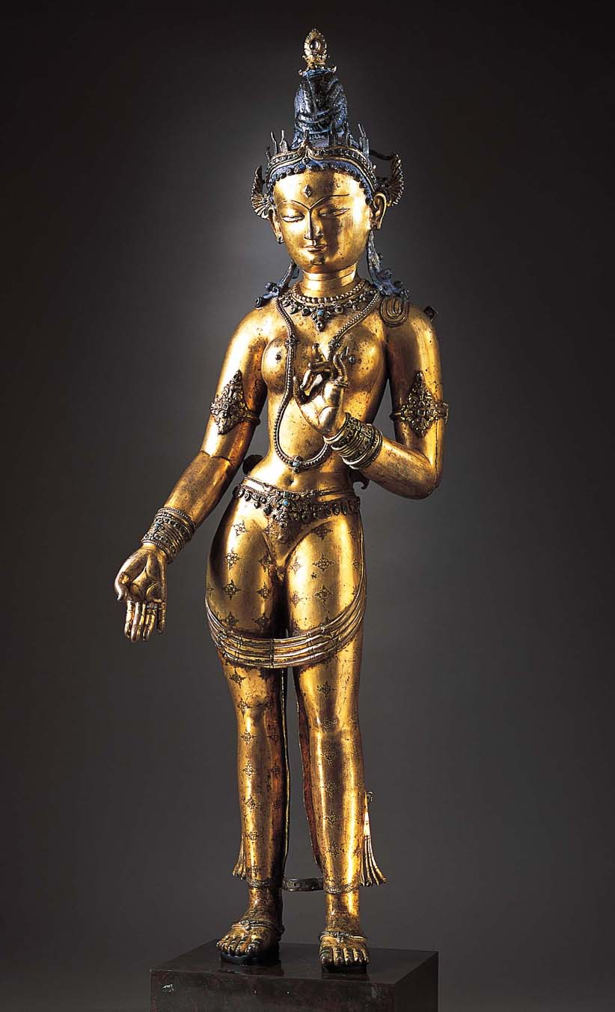
Notes:
Tara, 14th century
Nepal or Tibet
Gilt-copper alloy with semiprecious stones and pigment
The Norton Simon Foundation
https://www.nortonsimon.org/art/detail/F.1976.05.01.S/

Slide 5
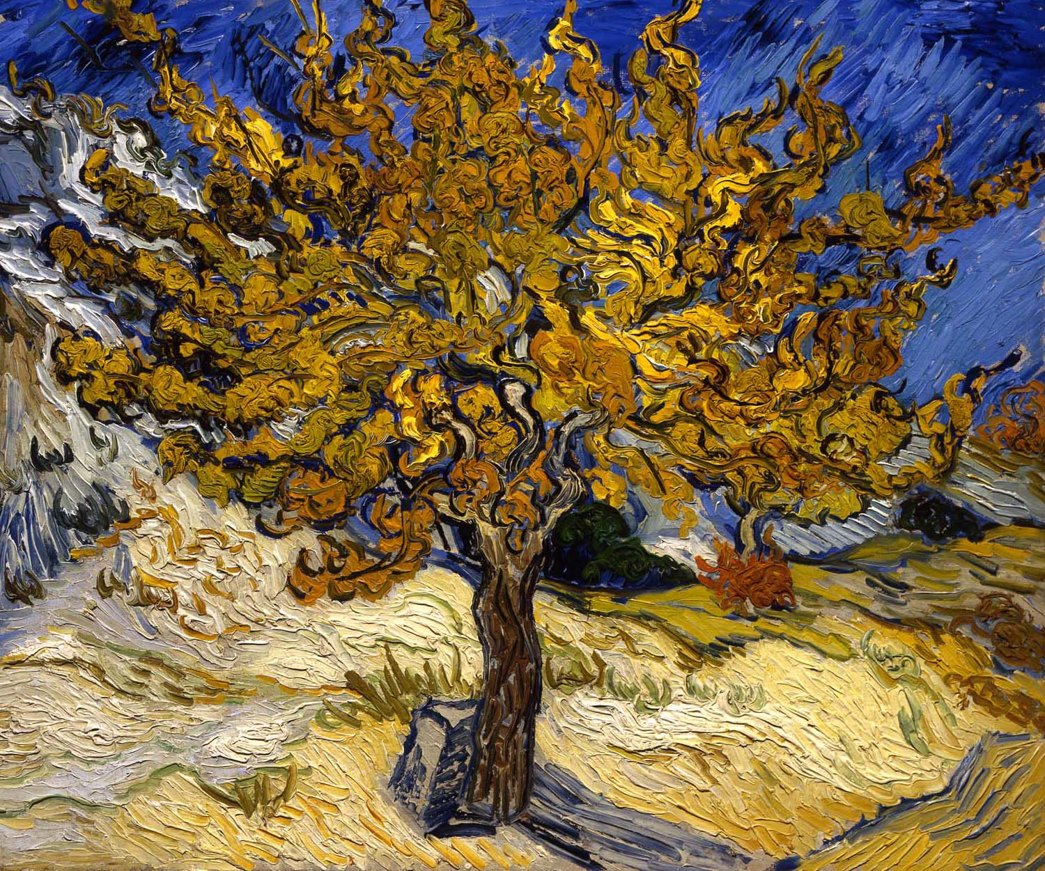
Notes:
Vincent van Gogh (Dutch, 1853–1890)
The Mulberry Tree, October 1889
Oil on canvas
Norton Simon Art Foundation
https://www.nortonsimon.org/art/detail/M.1976.09.P/

Slide 6
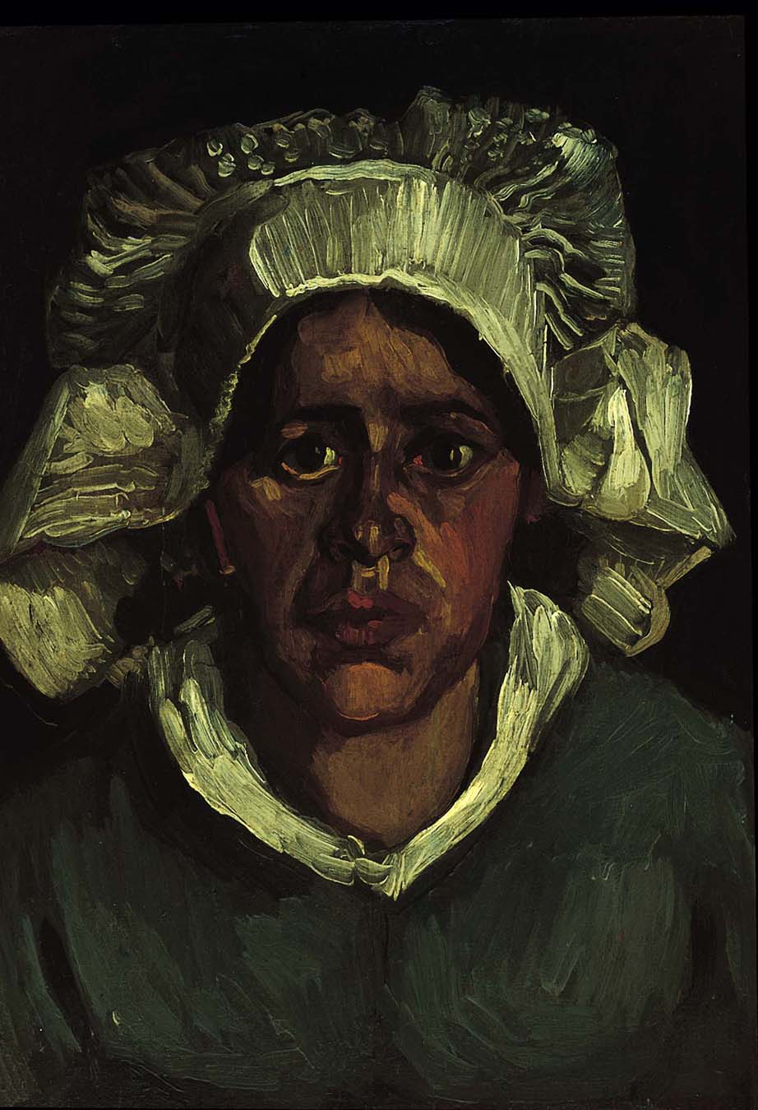
Notes:
Vincent van Gogh (Dutch, 1853–1890)
Head of a Peasant Woman in a White Bonnet, 1885
Oil on canvas
The Norton Simon Foundation
https://www.nortonsimon.org/art/detail/F.1985.1.P

